Slide 1





Multi-Kernel Correntropy Smoother for 6D Foot Motion Tracking with Inertial Sensors
Shilei Li, Dawei Shi, Yunjiang Lou,
Chenglong Fu, Lisheng Kuang, Ling Shi

Slide 2
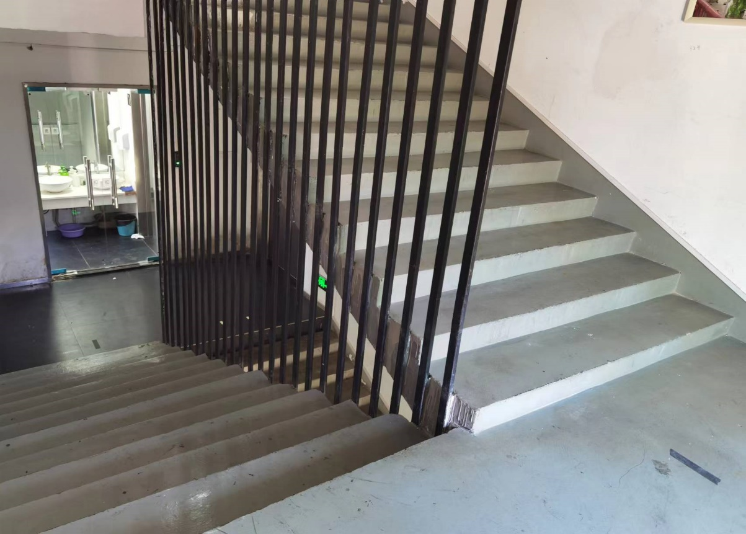
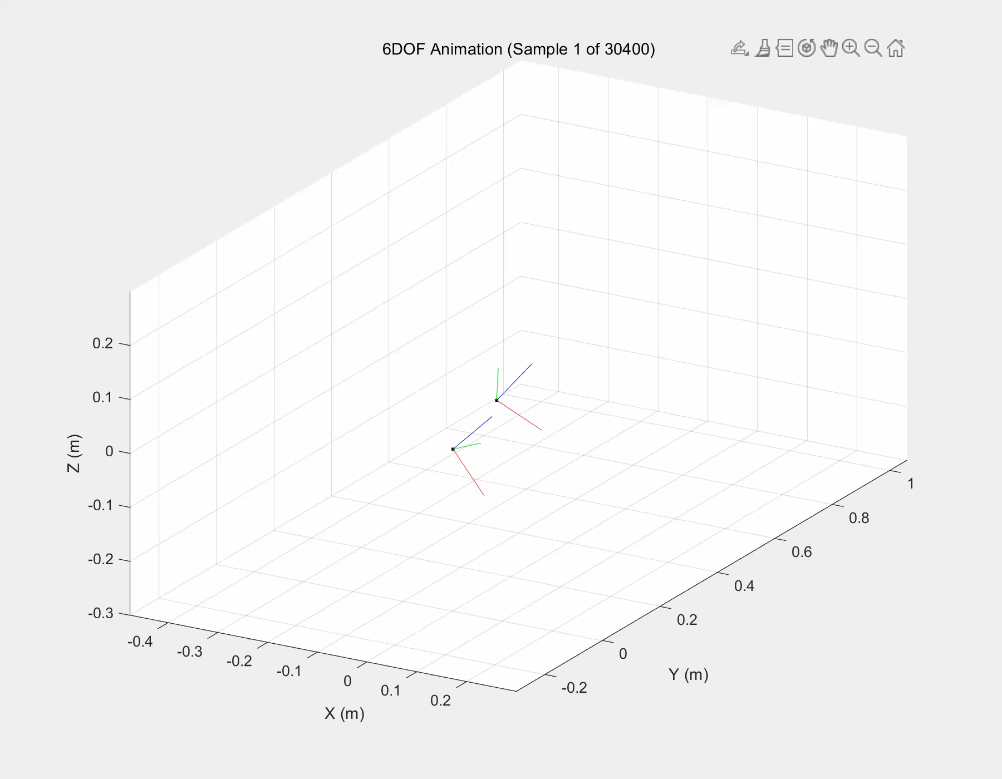
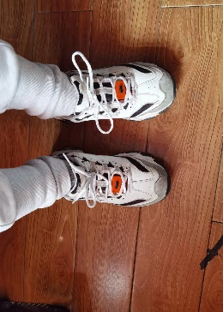
Stair Walking Animation
The initial position of the two IMUs was synchronized using the relative position of the left and right foot, as measured with a ruler. The subject walks using a natural walking speed and the detailed code is available in stair_walking_pilot_s3_intersection_rfoot_lfoot.m （ Stair_outdoor folder）.
Experimental setup
Foot orientation and trajectory animation

Slide 3
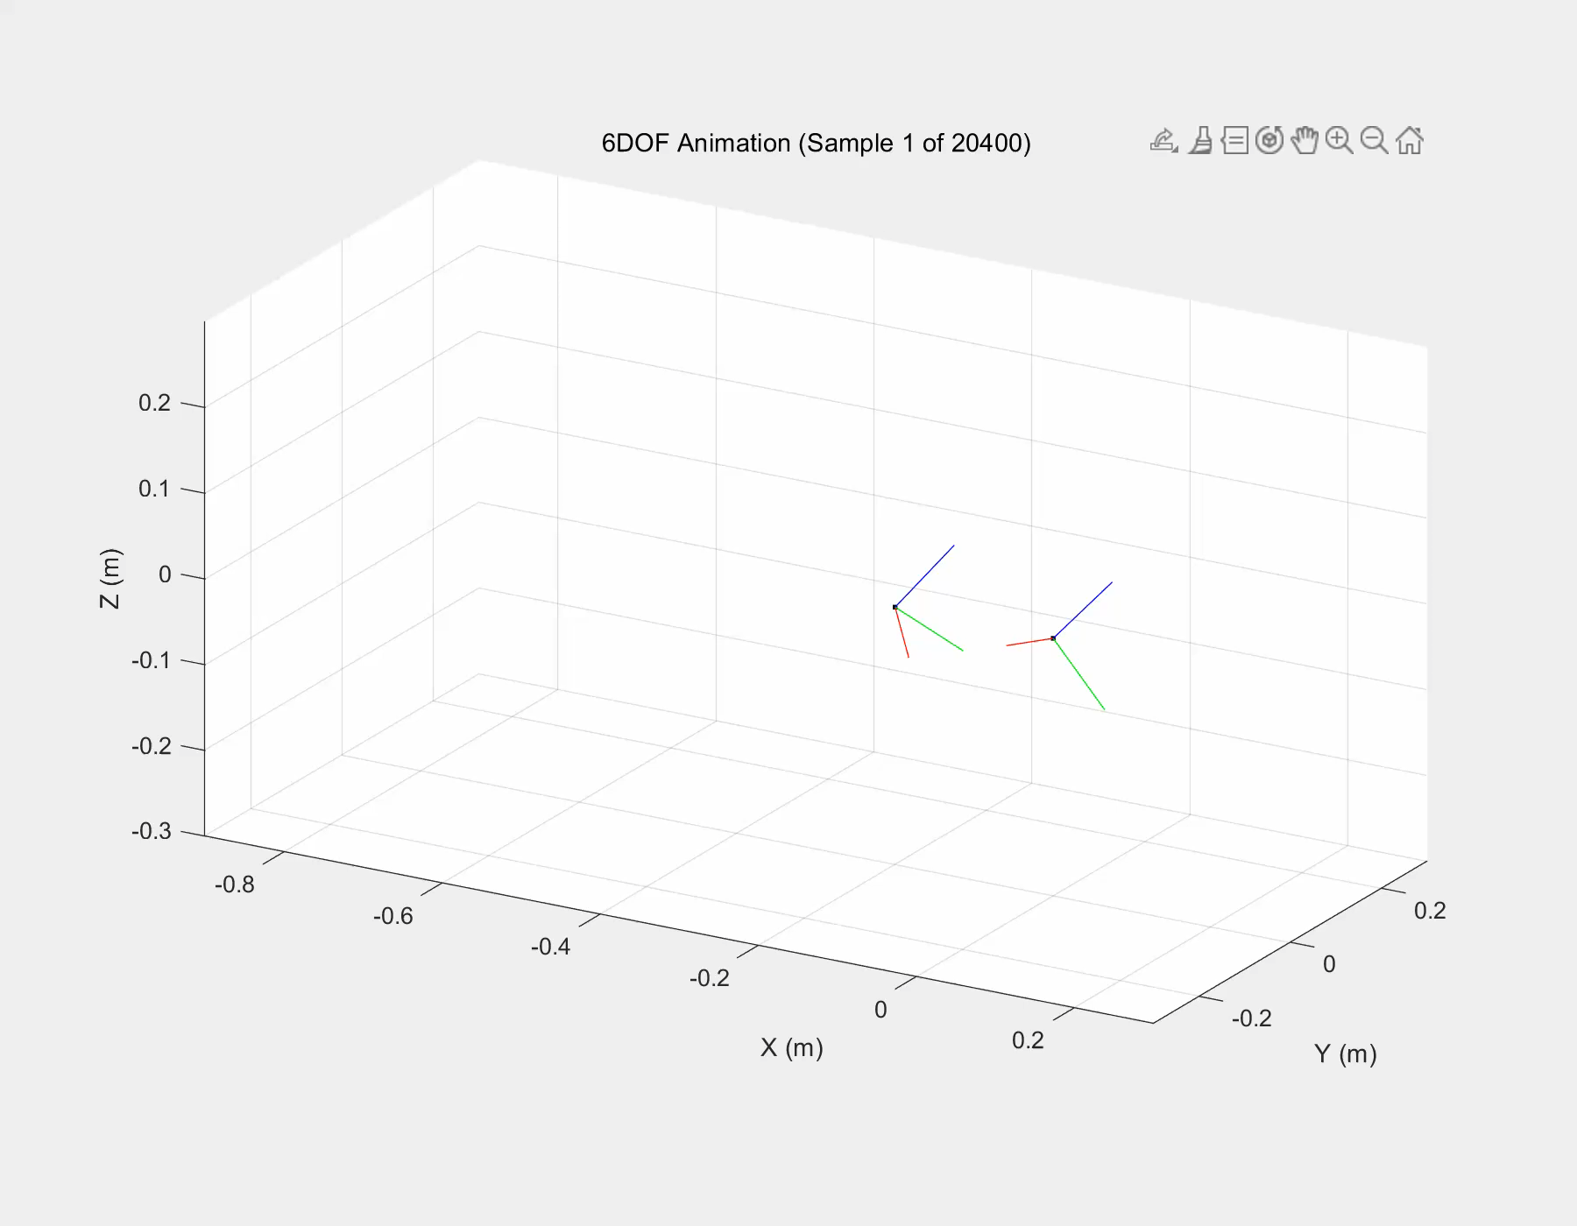
Indoor Walking Animation
The subject walks using a natural walking speed with both stairs and slopes. Details see: stair_slope_walking_rfoot_lfoot.m.
Experimental setup
Walking with stairs and slopes

Slide 4
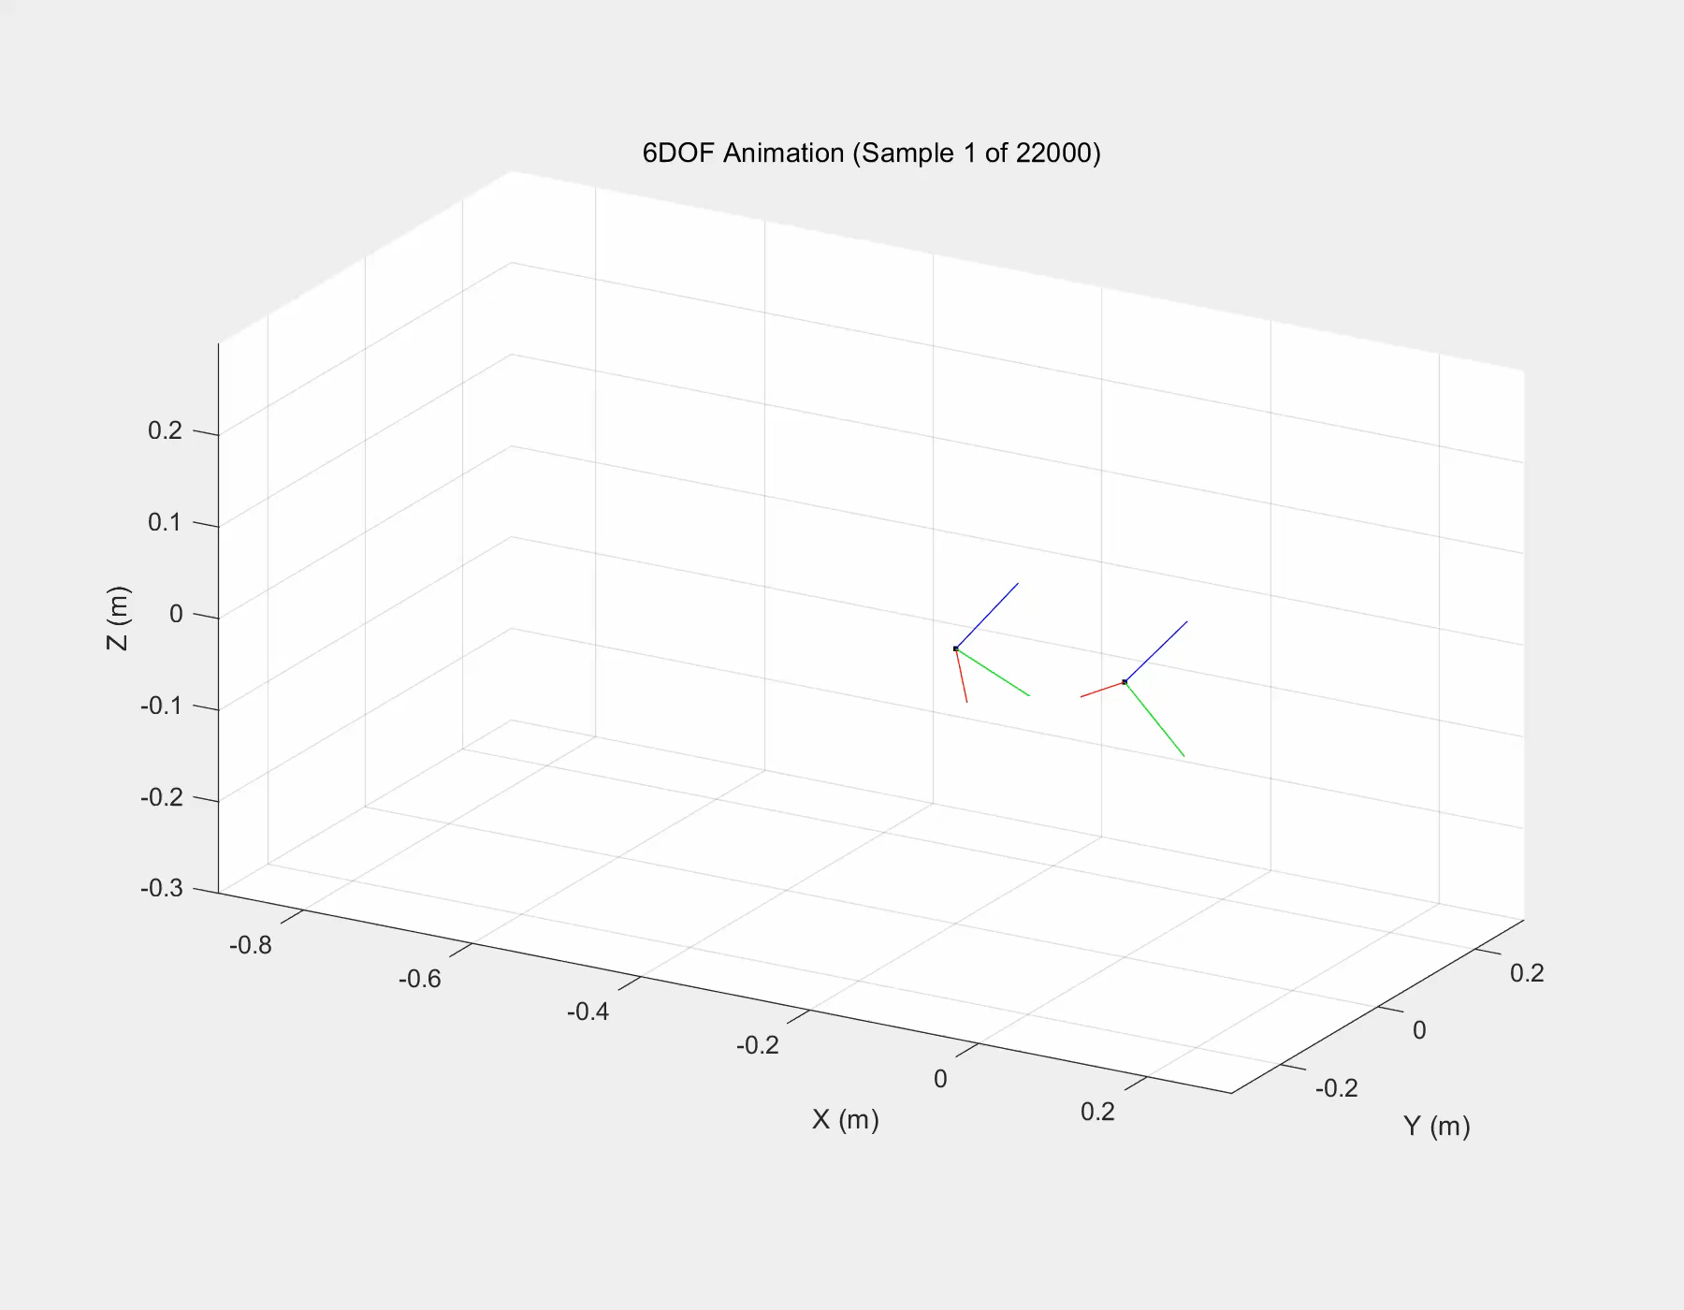
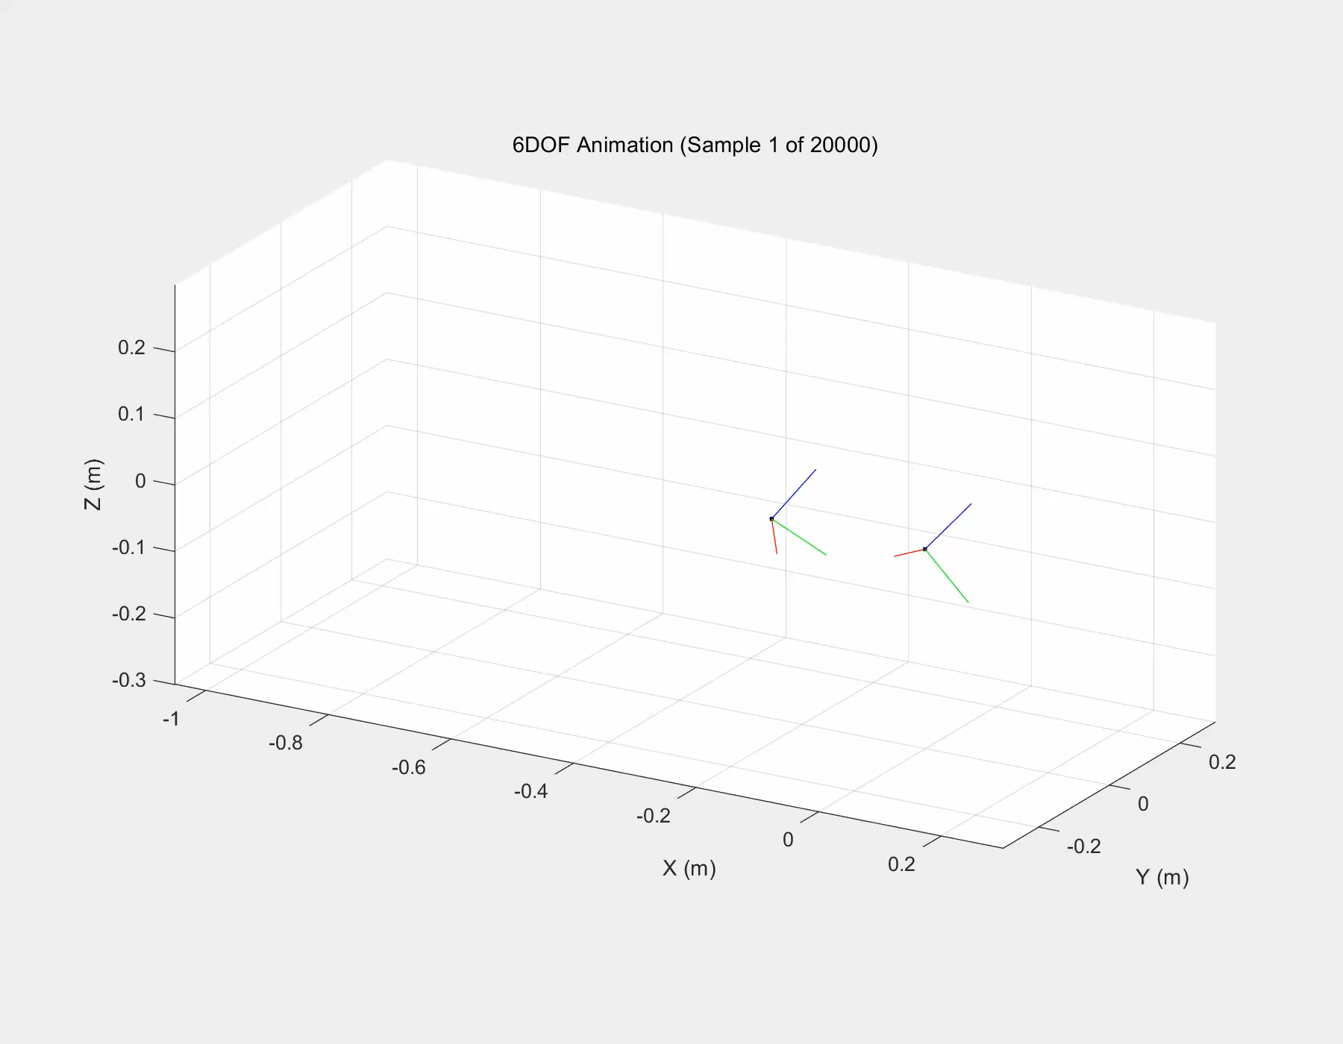
Indoor Walking Animation
The subject walks using a natural walking speed in two conditions: walking with stairs, and level walking. Details see: stair_walking_rfoot_lfoot.m; square_walking_rfoot_lfoot.m
Walking with stairs
Level walking

